Slide 1

DO NOT RULE UP YOUR PAGE YET!
Put your thinking cap on!
What is probability?
THINK – PAIR - SHARE

Slide 2
We are setting up a NEW section of your interactive notebooks for the next section!
From your last page of the measurement notebook skip one page and we will set up the new notebook.
You will have the page numbers start over again!

Slide 3
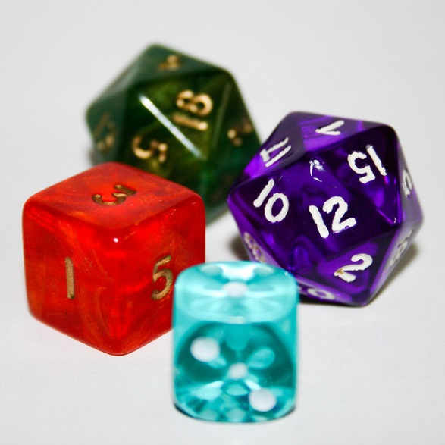
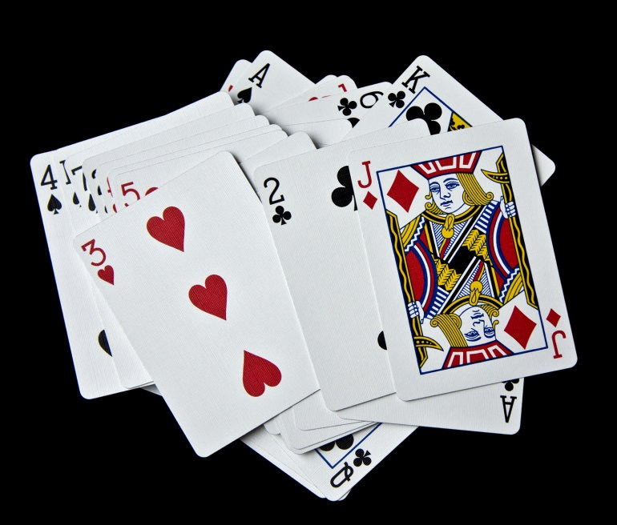
My Probability Interactive Notebook
Name
Class
Teacher
Term 4
1

Slide 4
Refresh
Probability
Language
Year 8
Mathematics

Slide 5
Graffiti activity
Break class into 5-6 groups
Each group has an A3 sheet
Each group has a different coloured marker
Have the students write the word Probability in the middle of the page.
Set a timer for 5 minutes
Have students in their group write as many words (with their definition) related to probability as they can think of as a mind map
Once the 5 minutes are up students move to another group and spend a set time adding to the other groups poster any words and definitions they can see missing or they can add.
Continue this until all groups have viewed and edited all of the posters.
Students return to their groups and then run through the power-point and make sure all of the words are included on their poster if not they should add them too the poster
Hang posters around the room.

Slide 6
Probability
Tells the chance that something will happen.

Slide 7
We use the words probability and chance to mean the same thing.
We hear and make statements that involve probability all the time.

Slide 8


Slide 9
So many things involve probability.
• Insurance is about probability.
• Weather prediction is about probability. • Gambling is about probability.
• Even atomic theory is about probability. • etc., etc., etc.

Slide 10
Event
Something that may or may not happen.

Slide 11
Outcomes
Possible results of a probability experiment

Slide 12
Chance —
A possibility or likelihood.

Slide 13
Predictions
When you use the probability of an event to make an educated guess.

Slide 14
Certain
Some events are certain and know that they must happen.
Ex. It is certain that the sun will rise in the morning.

Slide 15
Impossible
Some events are impossible and you know that they can never happen.
Ex. It is impossible that a pig will fly like a bird.

Slide 16
Equally Likely
Outcomes that have the same chance of occurring.

Slide 17
More Likely
Greater chance that an
event will happen.

Slide 18
Less Likely
Smaller chance that an event will happen.

Slide 19
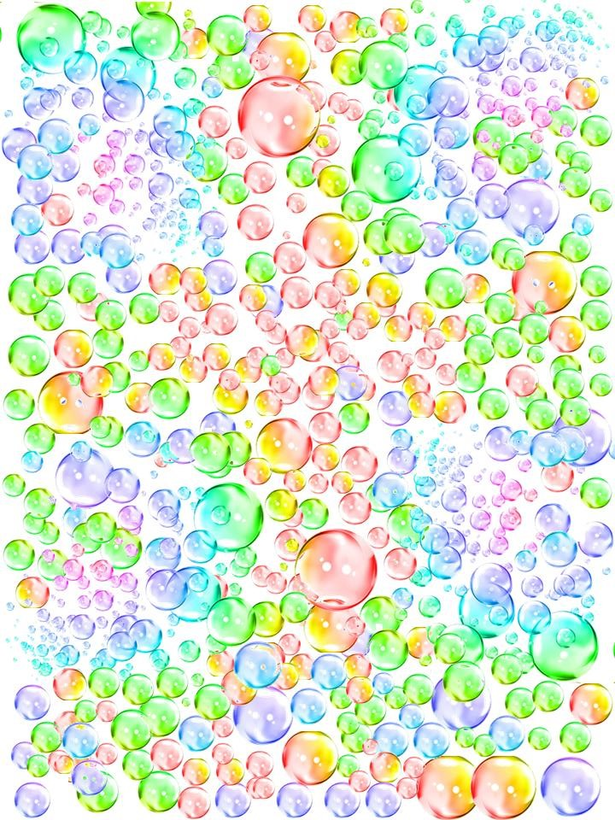
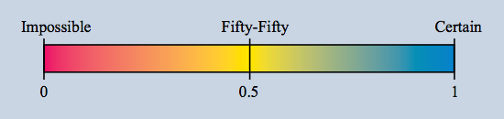
Where would the following fit on the above probability
a) The day after Monday will be Tuesday.
b) Next year will have 390 days.
c) We will have a new Maths teacher next week.
^{d) I will watch TV tonight.}
e) I will become the Prime Minister.
f) I will drink some milk today.
^{g) It will rain tomorrow.}
h) I will get my driver's licence before I am 21.
i) When a coin is thrown it will land tails up.
j) I will send a text message today.
k) The next movie I watch will be an action movie.
l) The next person to walk through the door will be a girl.

Slide 20
a) List 3 events in your everyday life that will be certain.
b) List 3 events in your everyday life that will be impossible.
c) List 3 events in your everyday life that will be approximately fifty-fifty.
d) The probability of tossing a coin and getting a head is fifty-fifty, or 0.5 or 1⁄2. If a coin is tossed 100 times, will the number of heads be 50?
e) The probability of rolling a die and getting a 6 is one-sixth, or 0.17, or 1/6. If a die is rolled 60 times, will the number of 6s be 10?
f) Almost every gambling game involving money is unfair.
g) We have Buckley's chance of winning the match.

Slide 21
Sample Space
A Sample Space is a complete list of all possible outcomes.
For example: Tossing a coin: There are two possibilities: head or Tail. The Sample Space is: S = {H, T}

Slide 22



The Sample Space for spinning the spinner.
^{S = {Green, Blue, Red, Yellow}}
The Sample Space for throwing a die.
S = {1,2,3,4,5,6}
The Sample Space for tossing a coin.
S = {H,T}

Slide 23

Theoretical Probability—
The probability of an event is the number of favourable outcomes divided by the number of possible outcomes.

Slide 24

Experimental Probability— probability based on the results of repeated trials of an experiment.
If the experiment is fair then with a large number of trials, the experimental probability and the theoretical probability should be similar.

Slide 25
Review quiz

Slide 26




Fractions
Remember when writing a fraction.
The denominator is
_______
And the numerator is
Top Number.
Bottom Number

Slide 27
Probability
Remember when writing a fraction.
The denominator is
_______
And the numerator is
_______________
_______
total.
the part you are talking
about.(Sample Space)

Slide 28
Probability
What is the probability of choosing a red marble?
Remember to simplify
all fractions

Slide 29
Probability
What is the probability of choosing a blue marble?
Remember to simplify
all fractions

Slide 30
Probability
What is the probability of choosing a orange marble?
Remember to simplify
all fractions

Slide 31
Probability
What is the probability of choosing a black marble?
Remember to simplify
all fractions

